Slide 1
ONLINE JOBS AND ITS IMPACT
NAME : P.NAVIN RAAJAN (192124109)
S.AJAY(192124147)
COURSE : PRINCIPLES OF MANAGEMENT
COURSE CODE : UBA3366

Slide 2
ABSTRACT :
This report is purely tells about the futuristic world where we can earn from home comfortably without any risk and investment through online.
In this project we are going see explore about “online jobs and its impact”

Slide 3
This project involves about what types of online jobs are there and how it influenced the modern world.
Thereby we are going to see about online scammers and how we can protect ourself from those scammers.
We are going to take some survey about online jobs from students.

Slide 4
OBJECTIVES:
Create awareness about online scammers
Create awareness about how online based jobs and industries will boom in future
Survey about online jobs
Generation profit from online jobs
Types of online jobs without any investment

Slide 5
INTRODUCTION:
The Internet has become an integral part of our lives. With just a click of the mouse, you can get all the information you need.
It’s a perfect medium to communicate with people through e-mails, chats, social websites. You can get news, play online games, do the shopping and much more.

Slide 6
Before the pandemic time our daily routine is fully offline but during and after COVID pandemic this situation become totally different. All the private and public sectors become digitalisation.
For example: Online classes , work from home , online data entries , online reservations , online payments.
So, now – a – days most of the youngsters including school students are showing their interest towards online based job and passive income stream.

Slide 7
Mark Zuckerberg, the 7th richest person in this world is an example of how successful you can be if you use it very wisely.
Indians are not far behind either. Many Indian bloggers making as high as $80,000 per month.

Slide 8
WHO CAN EARN THROUGH ONLINE:
ONLINE JOBS ARE FOR EVERYONE
From working people who want extra income including students, old age people, daily job workers, housewives, everyone can earn online.

Slide 9
For people who prefer working full-time online from the comfort of their homes, online jobs can be the best option.
Let’s see some types of online jobs

Slide 10
TYPES OF ONLINE JOBS
There are various types of online jobs available on the Internet.
You get Paid for doing some simple tasks, data entry, technical part-time jobs of your niche, surveys, etc.

Slide 11


TYPES OF ONLINE JOBS
PROFESSIONAL BLOGGER
ONLINE TUTOR

Slide 12


TYPES OF ONLINE JOBS
SOCIAL MEDIA MANAGER
RESUME WRITER

Slide 13


TYPES OF ONLINE JOBS
FREELANCE WEB DESIGNER
WEB DEVELOPER

Slide 14


TYPES OF ONLINE JOBS
TRANSCRIPTIONST
ONLINE AFFLIATE

Slide 15


TYPES OF ONLINE JOBS
MEDICAL CODER
ONLINE COURSES

Slide 16


TYPES OF ONLINE JOBS
DATA ENTRY
E – COMMERCE

Slide 17
DO I NEED TO MAKE ANY INVESTMENT
No, you do not have to make investments to earn online. There are many jobs online which require you to make certain deposits or pay software charges. Most of them are fake.

Slide 18
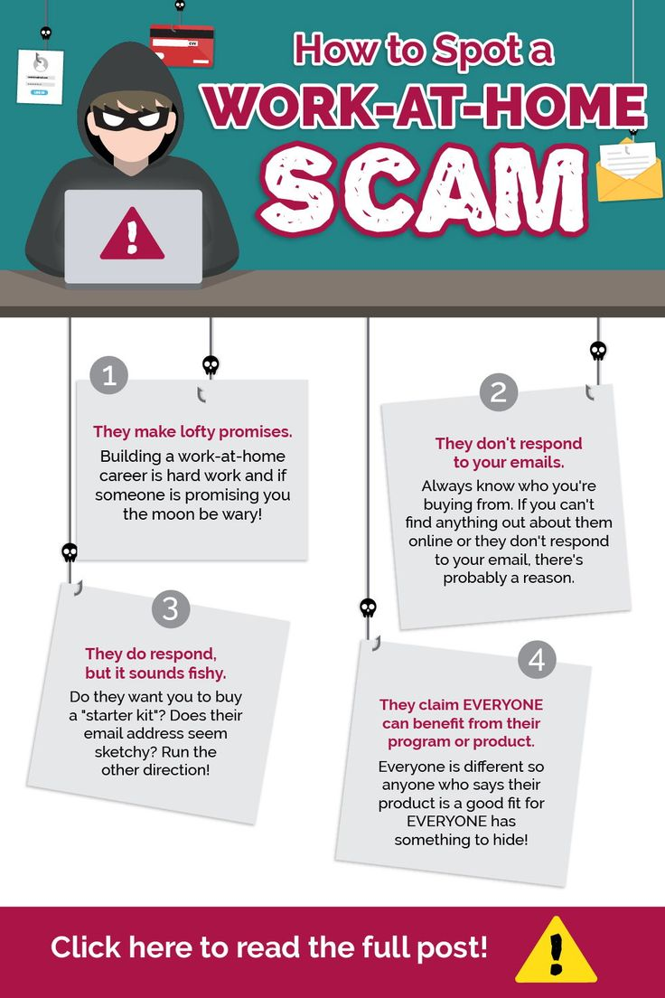
WORK AT HOME SCAM
Working from home has so many draws and is a major lifestyle goal for many people.
Scam artists capitalize on the dreams of these would-be remote workers by luring them with fantastic yet realistic-sounding work-at-home job opportunities.
The catch? They just need to send a wire transfer or money order upfront to pay for some equipment or educational materials before they can get started, but these never arrive, and there is no actual job.

Slide 19

PYRAMID MARKETING SCAM
Pyramid marketing is illegal and has no basis in real commerce . There is no product involved in a pyramid marketing scheme, just the exchange of money.
people invest in pyramid marketing because they believe they will benefit from investments made by people who follow them into the program.

Slide 20

CRYPTO CUURENCY SCHEME
With the cryptocurrency market being so volatile, it’s not uncommon to hear about massive gains over a short period of time. This makes classic pyramid or Ponzi schemes an easier sell to investors as people are less likely to view them as “too good to be true”.
Austrian investment scheme promised a whopping 4 percent weekly return to some investors and ended up reportedly stealing more than 12,000 bitcoins.

Slide 21

STUFFING ENVELOPS
This scam typically involves signing up and paying a fee to “stuff envelopes from home.”
Once enrolled, you receive a document explaining how to get others to buy the same envelope-stuffing opportunity you did.
You earn a small commission when someone else falls for the scam and pays the non refundable fee.

Slide 22
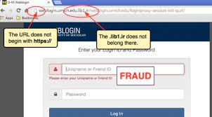
USING FAKE URLS
Scammers will try to recreate the legitimate company’s website by slightly altering the web address.
For example, a real company website might have the address, companyname.com.
But, when you’re looking at the fake website, the address is company-name.com. It’s a subtle change, but it could indicate you’re not on the company’s real website.

Slide 23
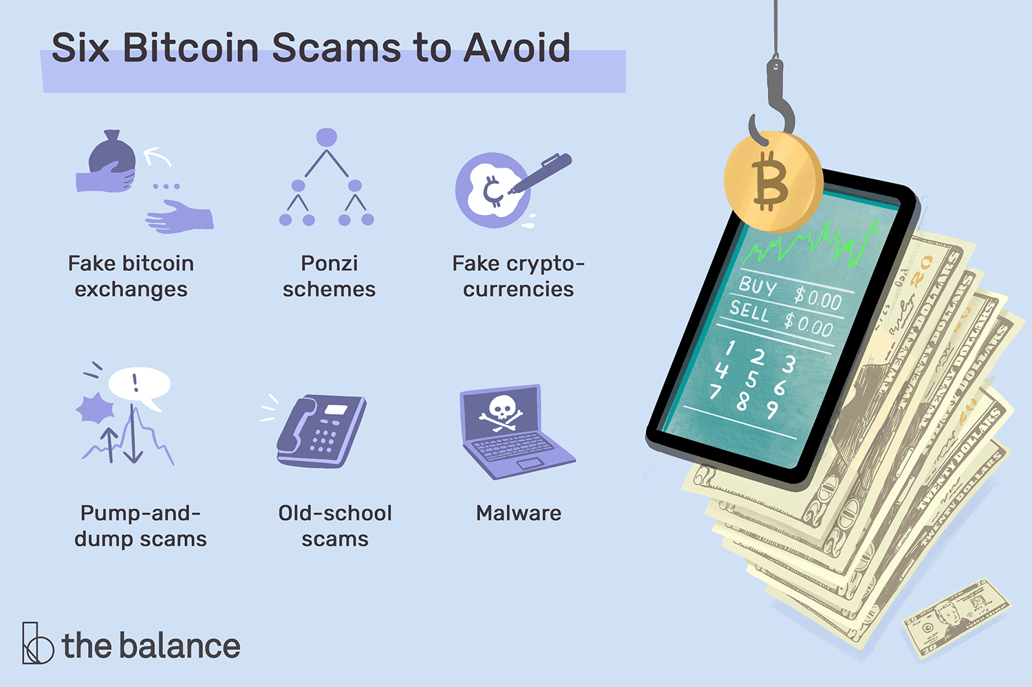
FAKE COIN EXCHANGE
Since so many cryptocurrency-related businesses are relatively new, it’s difficult to know which ones are legit.
Criminals have capitalized on this and simply take people’s money through fake or questionable exchanges.

Slide 24
HOW TO IDENTIFY JOB SCAMS:
The ad uses words that are probably too good to be true: quick money, unlimited earning potential, free work-from-home jobs.

Slide 25
There is a sense of urgency, or the recruiter is pushing you to accept the job now.
The job post or email has obvious grammatical or spelling errors.

Slide 26
You’re offered the job without a recruiter verifying your work experience or asking for references.
The “company” has an email domain from g mail or other popular providers.
The job description is unusually vague.

Slide 27
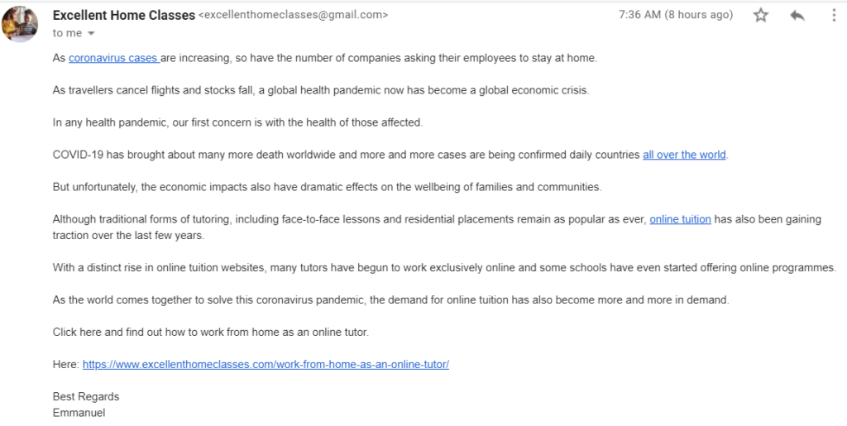
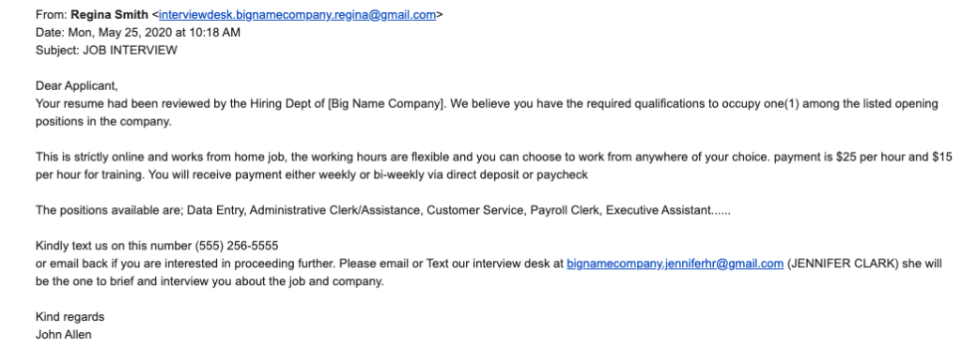
“Company” Domain Uses Gmail; Inconsistencies Within Email; Interviews via Text

Slide 28
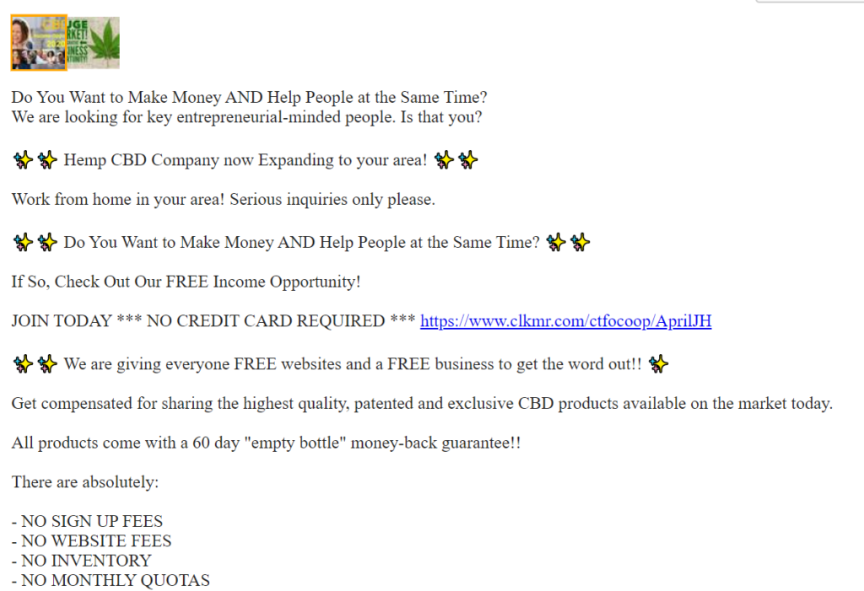

Vague Job Listing—No Company Name, No Job Duties Listed
Common Flyers Posted Publicly

Slide 29
6 SIGNS OF ONLINE JOBS SCAM
1. The Job Pays Way Too Much:
2. The Name of the Company Is Questionable:
3. You’re Offered the Job Much Too Soon:
4. You’re Asked for Personal Information Too Early:
5. There Are Grammatical and Spelling Errors:
6. The Contact Information Is Not Professional:

Slide 30
SURVEY
“ACCORDING TO FLEXJOBS RECENT ANNUAL SURVEY IT FOUND THAT MORE THAN 80% OF JOB SEEKERS REPORT BEING ON GUARD OR VERY CONCERNED ABOUT SCAMS ON OTHER JOB BOARDS. ACCORDING TO THE SAME SURVEY, ALMOST 20% OF JOB SEEKERS HAVE BEEN A VICTIM OF A JOB SCAM (UP FROM 13% IN 2016), WITH 22% OF JOB SEEKERS KNOWING SOMEBODY WHO HAS BEEN VICTIM OF A JOB SCAM.”

Slide 31
ONLINE JOBS
ADVANTAGES
DISADVANTAGES
Work at Your Own Pace, In Your Own Space
Say goodbye to long commutes:
Spend more time with your loved ones:
Get to wear comfortable clothes:
Minimal supervision:
:Internet is life
Distractions everywhere
You shoulder all expenses
Social isolation
Motivation can be difficult to find

Slide 32
SAGE JOURNELS Reducing Average Job Completion Time for DAG-style Jobs by Adding Idle Slots
Alexandrea J Ravenelle, Erica Janko, Ken Cai Kowalski new media & society 24 (7), 1591-1610, 2022
IEEE Global Communications Conference (GLOBECOM 2022), 2022 Sizes of data processing jobs in cloud clusters have been growing rapidly in the big data era. It is critical to execute those jobs efficiently
. We analyze the benefits of inserting idle time for simple cases theoretically and show the condition in which idle slots should be inserted for two adjacent jobs. In addition, we adapt the RL-based scheduler by integrating the observation.

Slide 33
SAGE JOURNELS Good jobs, scam jobs: Detecting, normalizing, and internalizing online job scams
In this article, based on in-depth interviews conducted between April and July 2020 with nearly 200 precarious workers, we find that precarious workers regularly encountered fraudulent job advertisements via digital media
In addition, the discovery that advertised “good jobs” are often scams affecting workers’ desire to continue job hunting and perceptions of potential future success.

Slide 34
JRASET JOURNELS Online Job Portal-A Better Way for Finding Jobs in the COVID-19 Pandemic
Due to the COVID-19 pandemic unemployment broke all the previous records. Due to the pandemic students cannot go to colleges and have no option of campus placements. The only option available for them is to find a job through online job portals
In this paper we present the online recruitment framework that enables different companies to post their job vacancies, which jobseekers can consider while searching for jobs.
The main aim of this job portal is to connect the employers and jobseekers as an e-recruitment to help jobseekers find the right

Slide 35
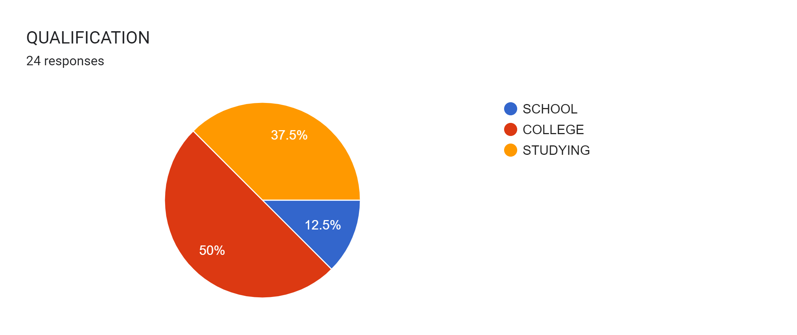
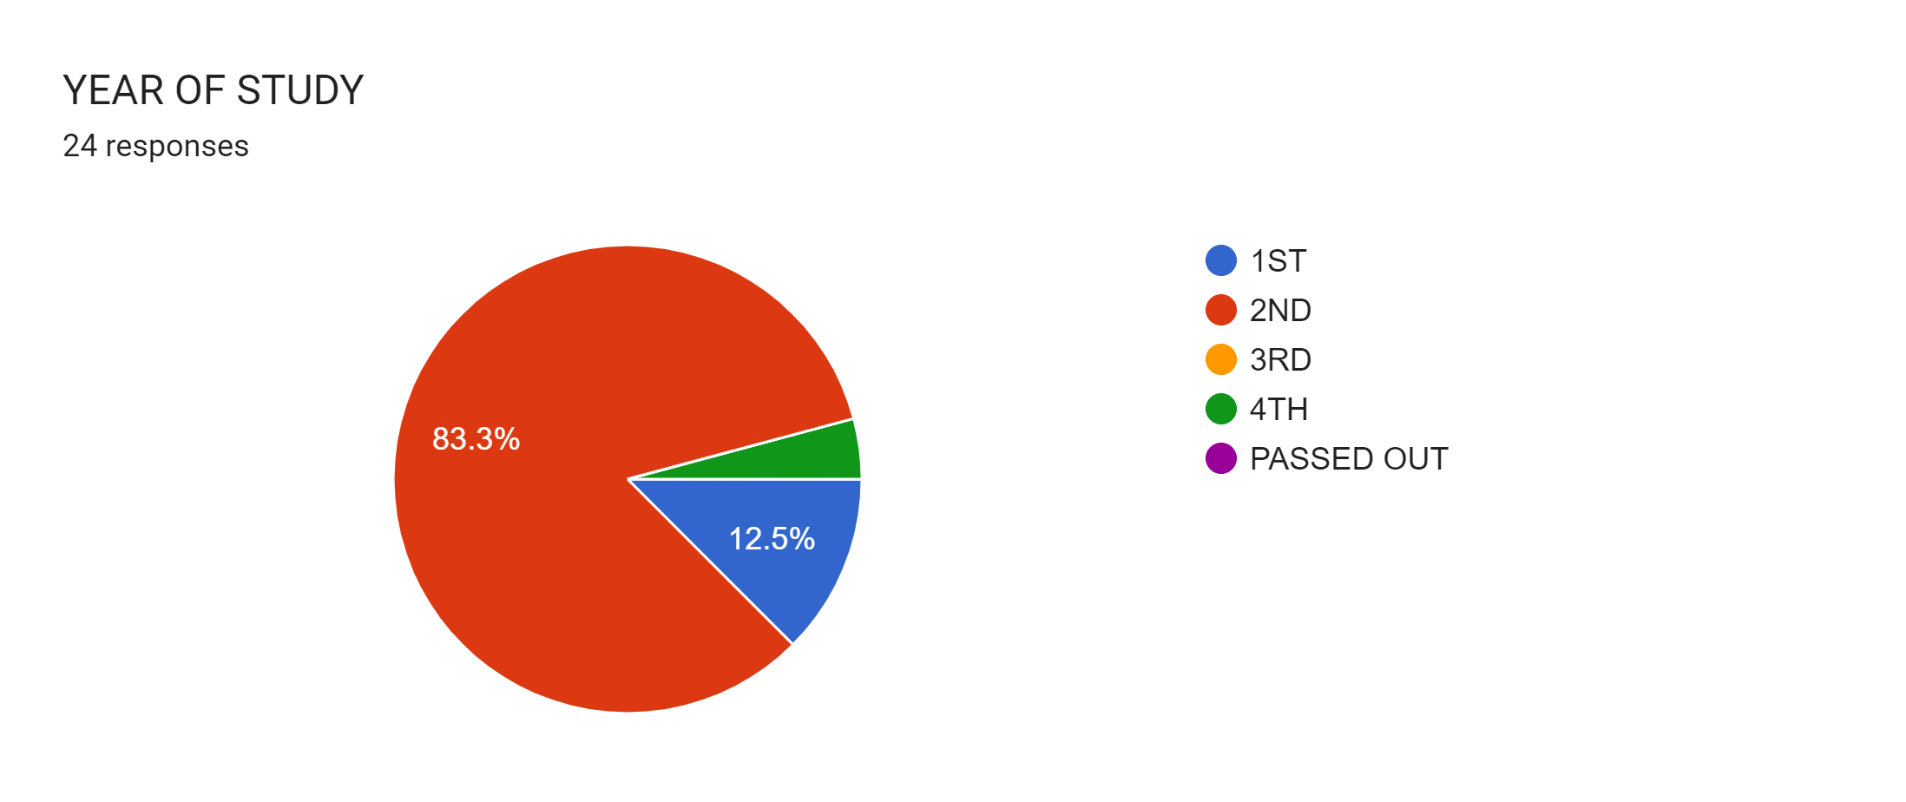

Slide 36
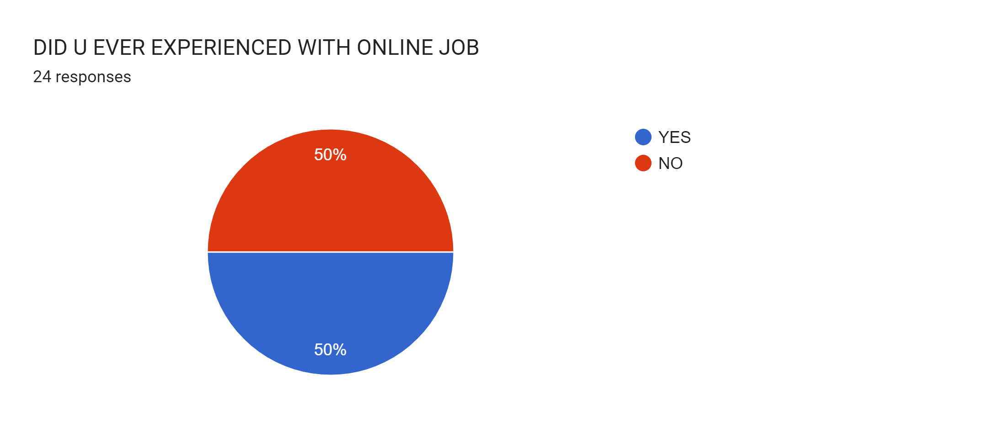
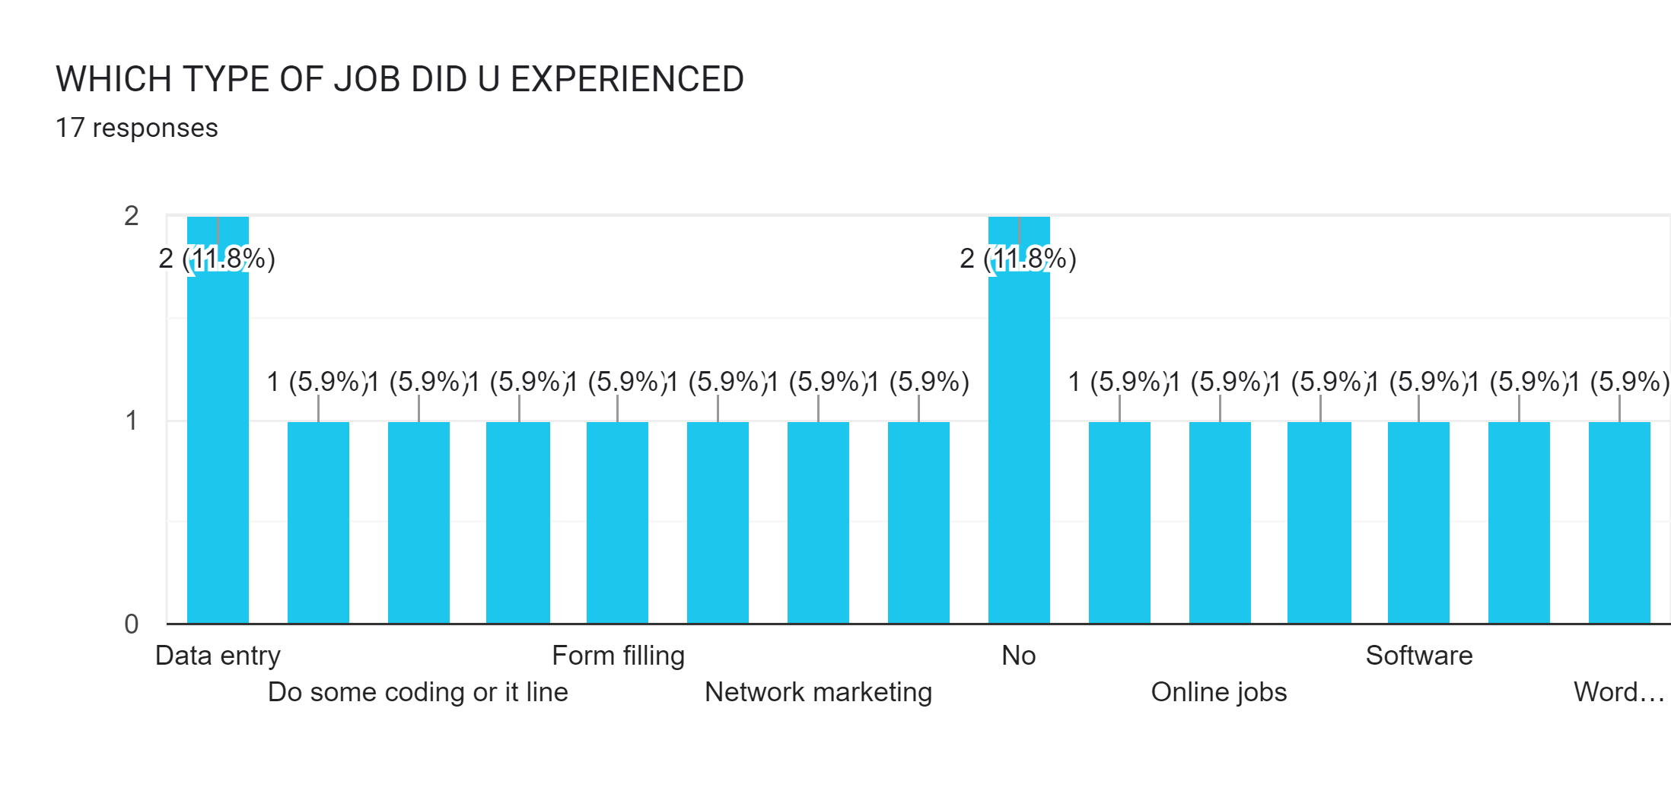

Slide 37
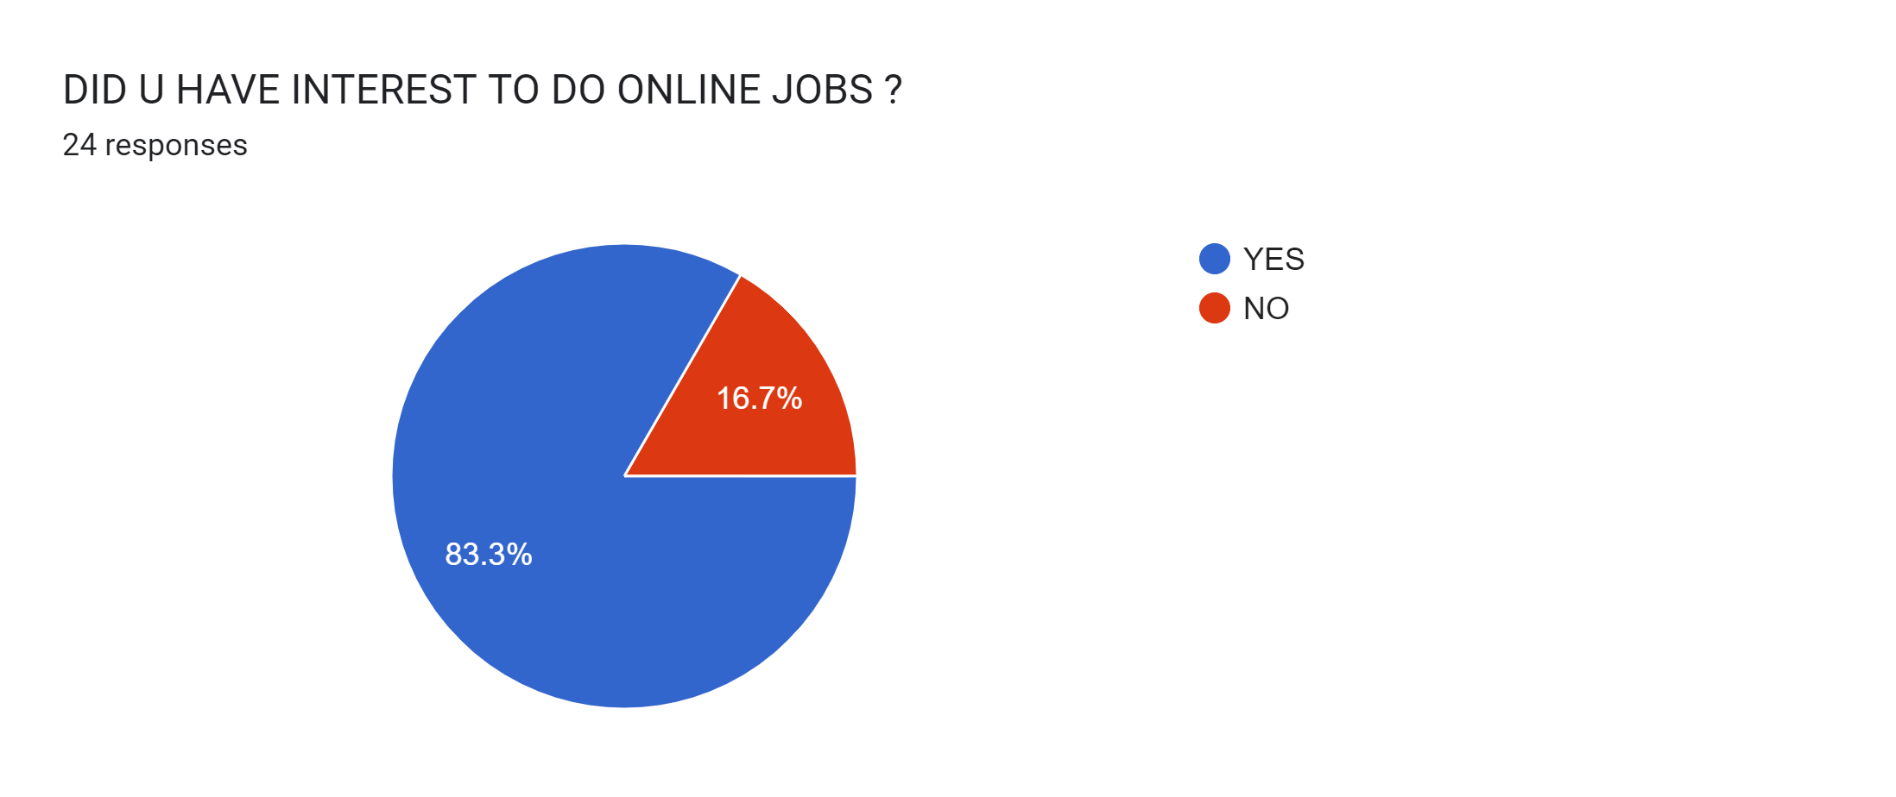
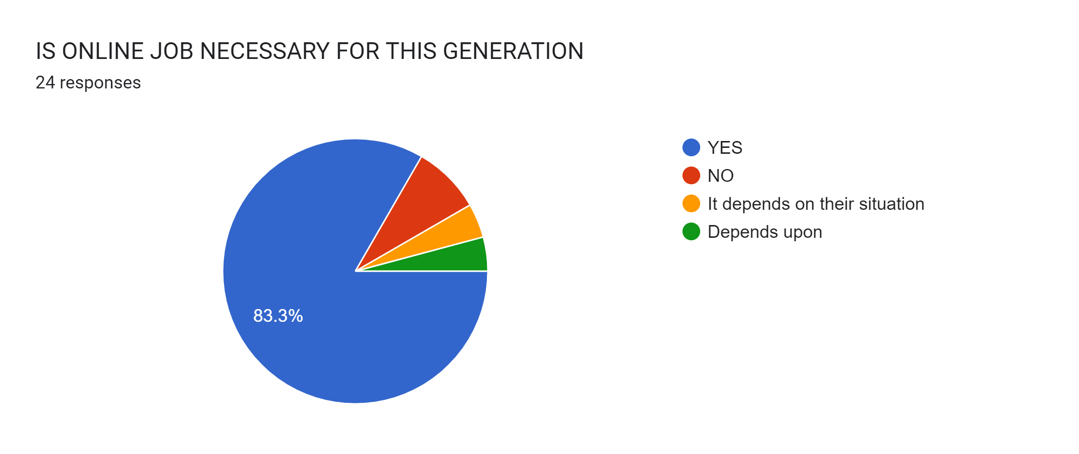

Slide 38
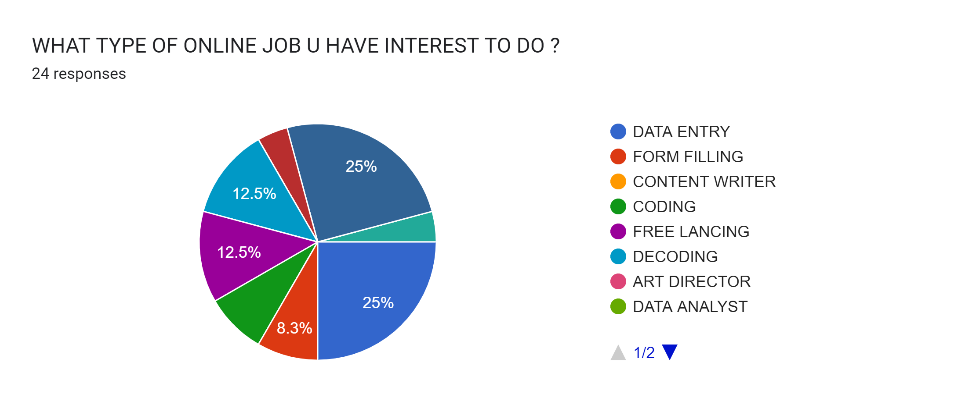

Slide 39
PROBLEM STATEMENT
.
You're pressed for time. ...
You lack a strong online presence. ...
You don't have a network. ...
You're not getting interviews. ...
You're getting interviews but no offers. ...
You don't know where to look. ...
You're competing with too many people. ...
You lack confidence

Slide 40
CONCLUSION
There are both pros and cons in online jobs , Now the world is moving towards online so we have to adapt ourselves to that technology change so we have to be aware of those scams which were proceed above and have to practice by doing small online jibs for our extra income source.
Online jobs are very useful for passive income stream by spending little amount of time to that specific work it will generate you a income till you works. So all the developed countries were adapted themselves for online based jobs , bussiness , conference .
As we are the youngsters of our country we have to enhance the important of online for future industry .
“JAI HIND”

Slide 41
REFERENCES

Slide 42
THANK YOU FOR YOUR KIND ATTENDTION

